Slide 1
Lippincott Solutions

Slide 2
What is Lippincott Solutions?
“Lippincott Solutions is a series of comprehensive, integrated software applications that includes advanced online workflow technology, current evidence-based clinical information, and professional development tools for clinicians.”
“Lippincott Solutions lead a nursing transformation and empower nursing staff with evidence-based solutions that help nurses deliver consistent patient care”
-Wolters Kluwer N.V., 2024

Slide 3
The Lippincott Solutions Suite:
Lippincott Procedures
Lippincott Advisor
Lippincott Professional Development
Lippincott Learning
Go – to for all skill based questions with over 2,100 procedures
100% Evidence Based
Includes Images and Videos
References included for research, projects, going back to school, etc.
Go – to for all clinical decision support with over 17,000 topics
100% Evidenced Based
Review Diseases & Conditions, Signs & Symptoms with Nursing considerations, Diagnostic Tests, Drugs with Nursing Considerations, and Patient Teaching Handouts
Over 400 interactive, online courses with competency validation & continuing education contact hours – free of charge!
Courses can be used for license renewal
CE Certificates Provided
Over 2,000 online journal articles
For individual enrollment & use for license renewal
Can be accessed from any computer

Slide 4
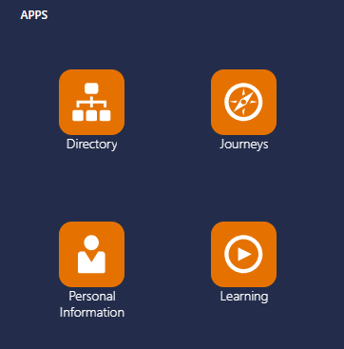
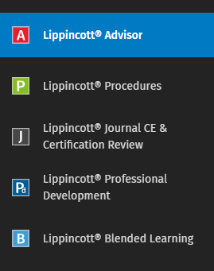
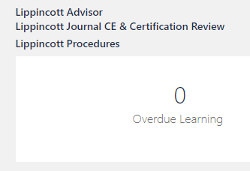
Accessing Lippincott from Oracle:
1. From the Oracle Home Page, under the “Apps” heading, click on the link titled “Learning”
2. At the top left of the page click on the link to the area of Lippincott you would like to view
3. With any area of Lippincott you choose, there will be a tool bar on the left of the page that when you hover over it, it will display the links to allow you access to all sections of the Lippincott Suite.

Slide 5
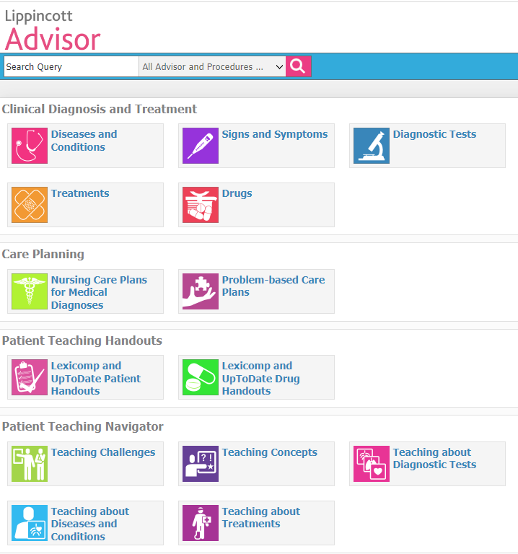
Lippincott Advisor:
Looking for more information about diseases & conditions?
Want to know what is abnormal for a certain lab value?
Need more information about a new drug that was ordered that you might not be familiar with?
Need patient teaching resources for a disease, condition, or a diagnostic test?
USE LIPPINCOTT ADVISOR!!

Slide 6
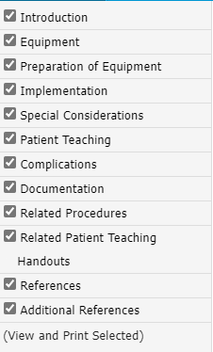
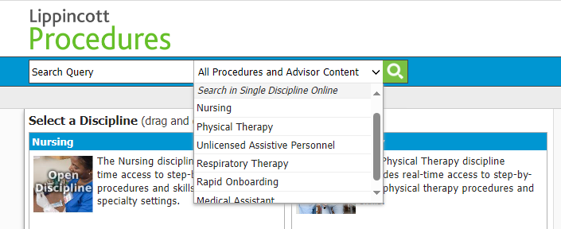
Lippincott Procedures:
Performing a new procedure or one that you have previously performed but need to refresh your knowledge?
USE LIPPINCOTT PROCEDURES!
2) In your search result for the procedure you will find all of the information listed to the left. Each section will give detailed descriptions, step by step instructions, as well as images to display devices you may need as well as images displaying the actions taken during different steps within a procedure. It will guide you through from start to finish.
1) In the drop down shown above you can search for a procedure within the category of your specialty. In the box to the left shown above that states “Search Query”, search the procedure you would like to learn more about, such as “NG Tube insertion”.

Slide 7
Lippincott Procedures Continued:
3) You can also click on the links for each section at the top of the page (shown in the image to the left) to obtain a simple skills checklist, view only images, or view the procedure step by step in videos.
This is a great resource for personal learning and knowledge refreshment as well as teaching, precepting, and skills validation.
4) All references and citations are included at the bottom of the “Procedure” section for use with research, projects, and going back to school.

Slide 8
Lippincott Learning Journals:

Slide 9
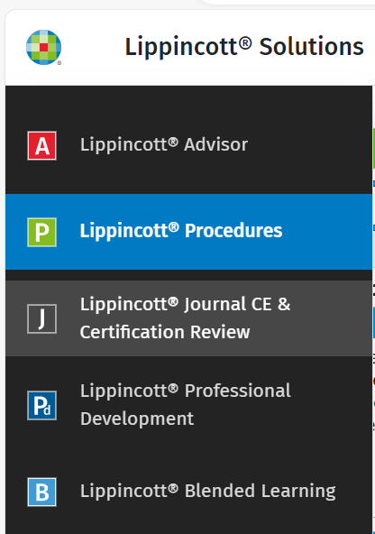
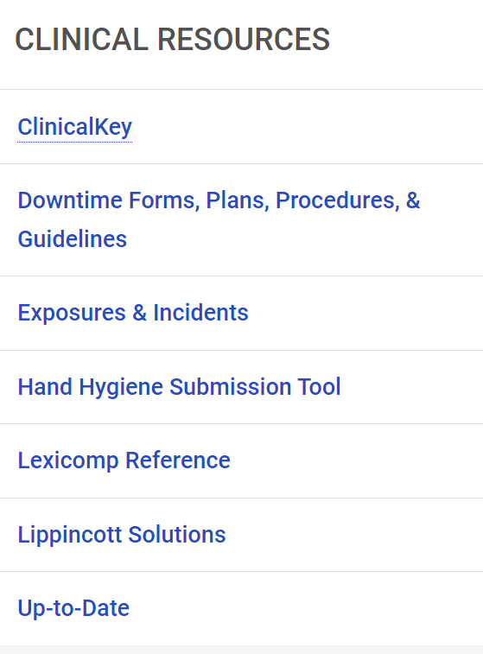

Slide 10
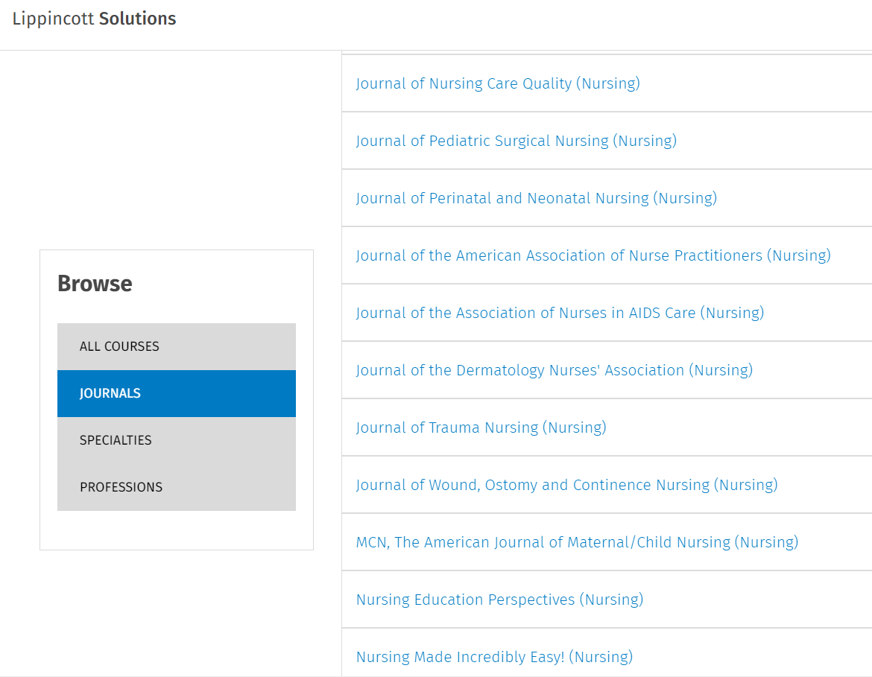
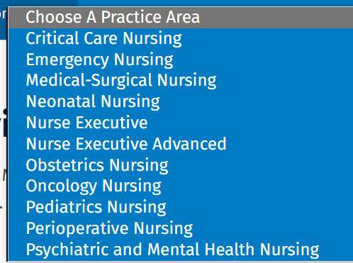

Slide 11
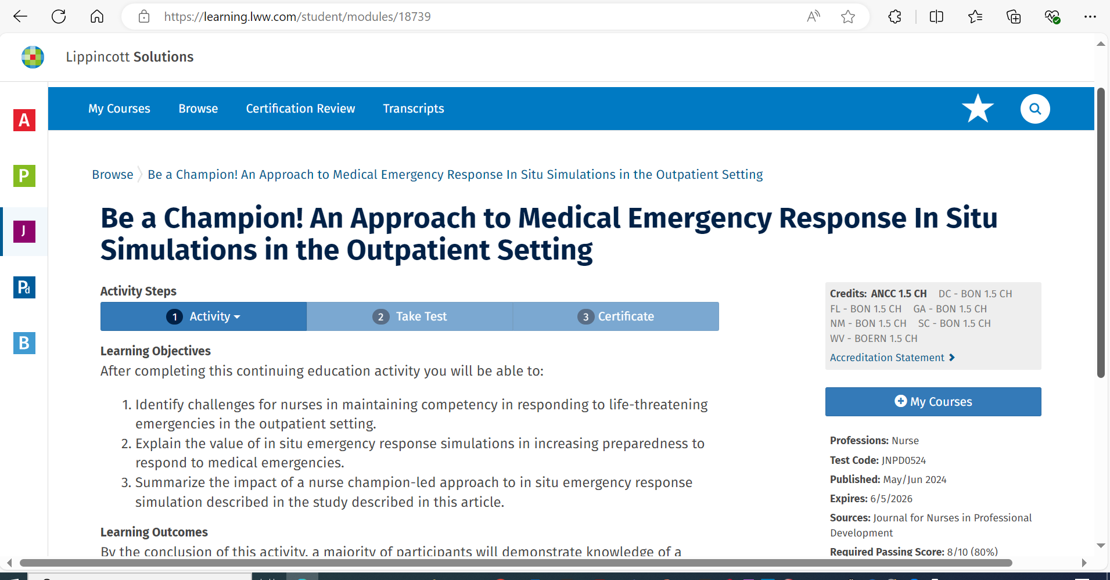

Slide 12
“To know what you know and what you do not know, that is true knowledge.”
Confucius

